Slide 1
Virtual Teachers' Conference: Student Support and the Academic Journey
Prof. Sarah Elton
Deputy Executive Dean for Education and Student Experience
Social Sciences and Health Faculty

Slide 2

Moving into higher education
Range of experiences moving into higher education: no typical student
Especially challenging during Covid-19 pandemic

Slide 3
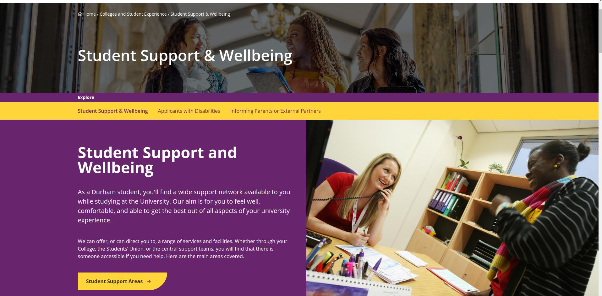
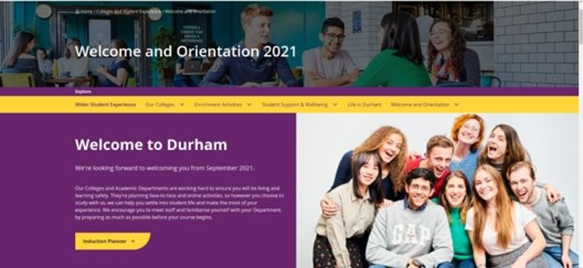
How we support students
Support needs to be inclusive, predictive and responsive
Multiple sources of support alongside Department across the whole student journey:
Transition into HE project
Induction
Support services
Collegiate support
Durham Centre for Academic Development (DCAD)

Slide 4
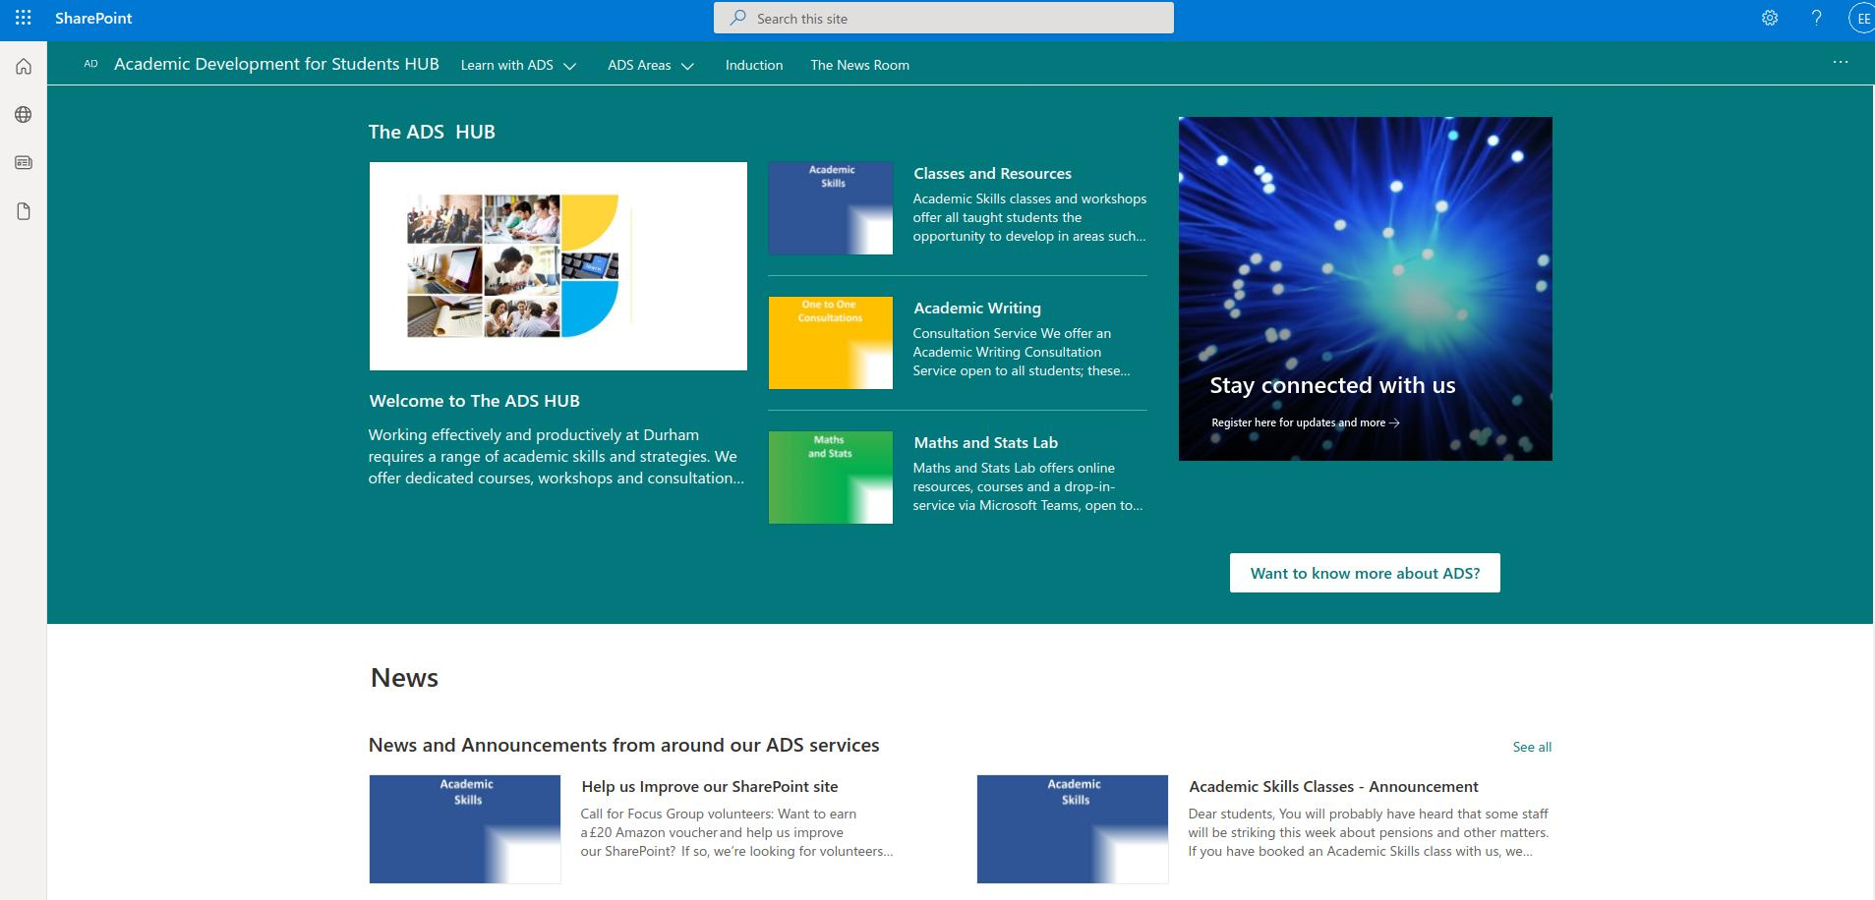
It's not just about induction week
Extended induction (e.g. skills, including transferable and practical)
DCAD Academic Development Hub
Academic advising in Departments
College mentoring schemes
Students' Union
Careers, Employability and Enterprise Centre

Slide 5

Student journeys
Opportunity to develop specialist academic interests (e.g. via dissertation)
Placement and study abroad years
Transferable skills augmented by wider student experience

Slide 6

Any questions...?
With thanks to...
The organisers for the invitation
DEDs in the other Faculties
You, for attending.

